Slide 1
2018.2.8. 목요일 16:00pm 암정복과제 유전체분석 화상모임 review of journals (+suggestion)
발표자: 홍지형

Slide 2


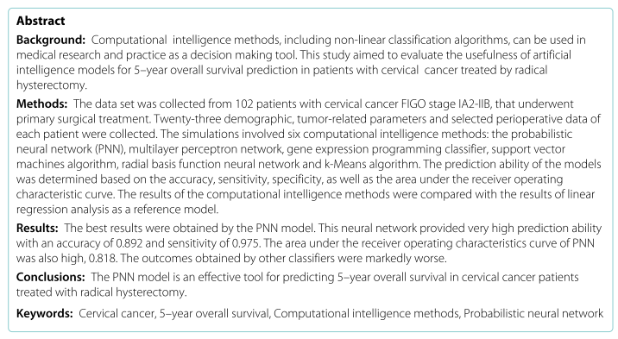

Slide 3
Background
Cervical cancer, the 4th most common malignancy worldwide.
The established platform for planning the treatment, FIGO classification
Although the FIGO staging system serves as the main tool for estimating the general prognosis, it does not include all established prognostic factors (lymph node metastases, lymph-vascular space invasion, deep stromal infiltration, or histologic subtype)
Another method for individual prediction of survival is the recently developed nomograms based on selected demographic and clinical parameters.
None of these systems take into account intra/postoperative complications and concomitant diseases, however, which could alter patients outcome.
The aim of the present study was to develop a universal model for predicting overall survival in individual patients with cervical cancer, based on the demographic characteristics, tumor-related parameters, and selected perioperative data.

Slide 4
Variables
In total, 23 variables were identified, including
4 demographic characteristics: age, BMI, hormonal status, presence of concomitant diseases
13 tumor-related parameters: FIGO stage, histologic type, grade, tumor size≤ 4cm or> 4cm, lymph nodes status, number of lymph nodes dissected, number of positive lymph nodes, lymph node ratio (ratio of positive to totally removed lymph nodes), lymph-vascular space invasion, surgical margins status, parametrial involvement, deep stromal invasion (outer 1/3 of the cervical stroma), postoperative radiotherapy
6 selected perioperative variables: surgery time, median blood lost, presence of intraoperative complications, presence of postoperative complications, type of complications, and length of hospital stay.
To present continuous values, the median measure (along with variable range) was used.

Slide 5
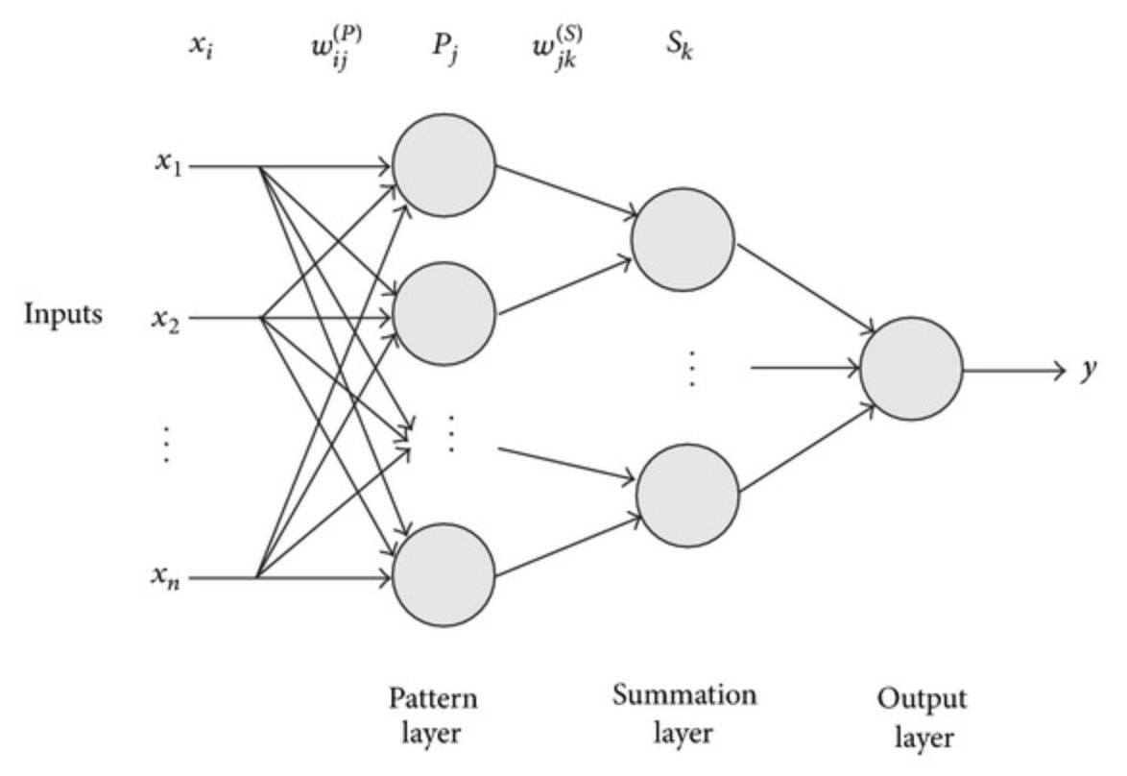
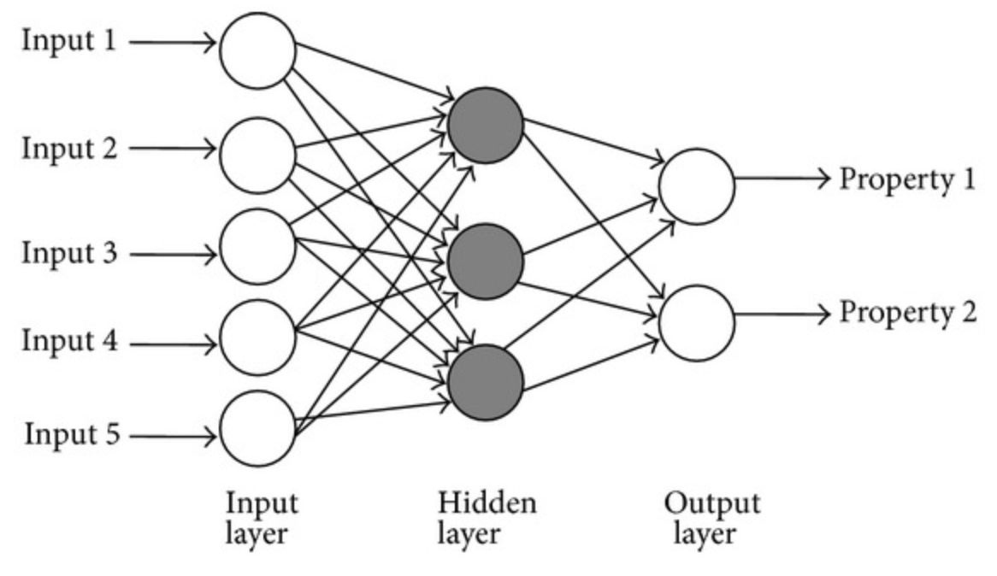
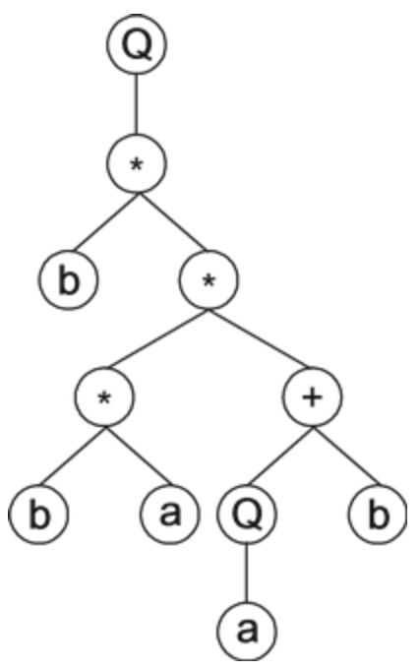
Six classifiers
probabilistic neural network (PNN)
a feedforward neural network.
composed of the input layer represented by the variables of the input vector, the pattern layer and the summation layer consisting of G neurons where each one computes the signal only for patterns that belong to gth class.
The output layer of the network determines the label for a classified vector in accordance with Bayes’s decision rule based on all the summation layer neuron signals.
The performance of PNN can be optimized by selecting the form of the smoothing parameter (sp) used for activation of neurons in the pattern layer.
multilayer perceptron network (MLP)
a feedforward neural network.
composed of an input layer, hidden layers, and an output layer.
The number of hidden layers, the optimal number of neurons in hidden layers and the appropriate activation functions must be determined for this model.
gene expression programming classifier (GEP)
an emulating biological evolution algorithm that creates and evolves computer programs.
The programs are encoded by chromosomes composed of the genes.
Within the population, evolution is performed by computing the expression of each chromosome, applying predefined genetic operators and calculating the fitness.

Slide 6
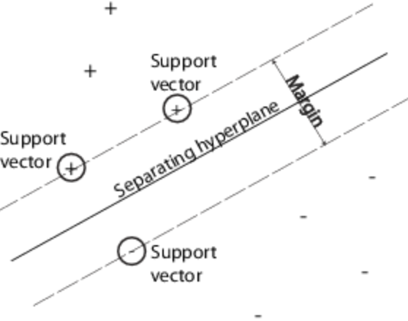
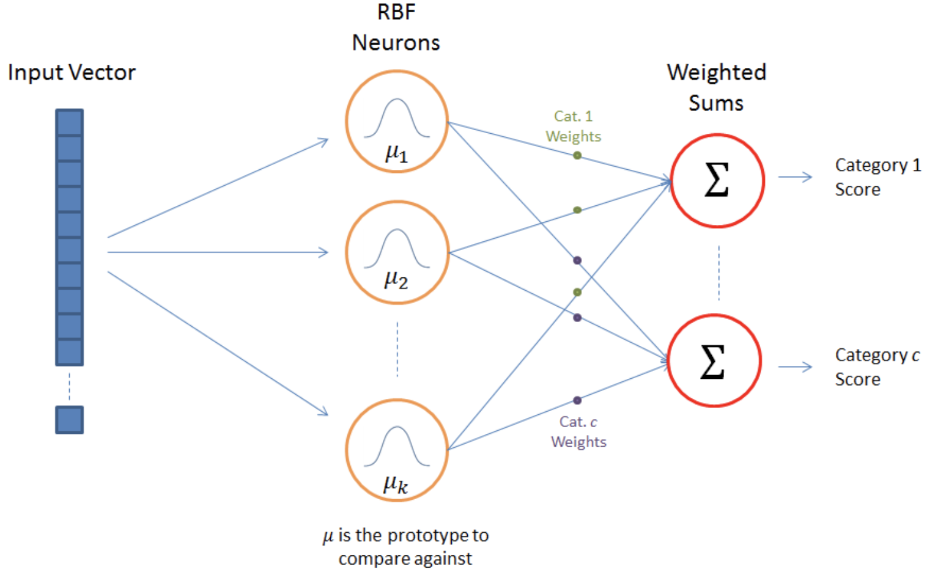
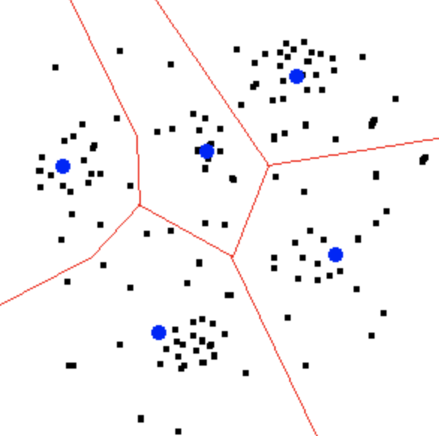
Six classifiers
support vector machines algorithm (SVM)
the classification algorithm
requires solving the quadratic programming optimization problem
various kernel functions and their parameters need to be explored.
the model’s capacity control parameter C must be selected.
radial basis function neural network (RBFNN)
RBFNN, similar to PNN and MLP, is a feedforward neural network.
This model consists of three layers: an input layer, a radial basis hidden layer, and a linear output layer.
The number of neurons in the hidden layer and the parameters of the RBFNN training method must be found.
k–Means method
The k–Means clustering algorithm partitions input data into k clusters and provides a center of each cluster.
As a result, the records within each cluster are similar to each other and distinct from records in other clusters.
The predictions for the unknown cases are made by assigning them the category of the nearest cluster center.

Slide 7
Statistical analysis
The prediction ability of the models was determined based on the accuracy (Acc), sensitivity (Sen), specificity (Spe), and the area under the receiver operating characteristic curve (AUROC).
The above parameters were obtained using a 10-fold cross validation procedure.
The simulations were conducted 20 times, preserving a random selection of subsets.
The results were averaged and the standard deviation was computed.
As a reference model, we applied the logistic regression analysis.
The AUROC value of particular classifiers and logistic regression model were compared using pairwise T-tests.
Differences were considered statistically significant when p<0.05. All statistical analysis were performed using MathWorks’ Matlab R2012a software.

Slide 8
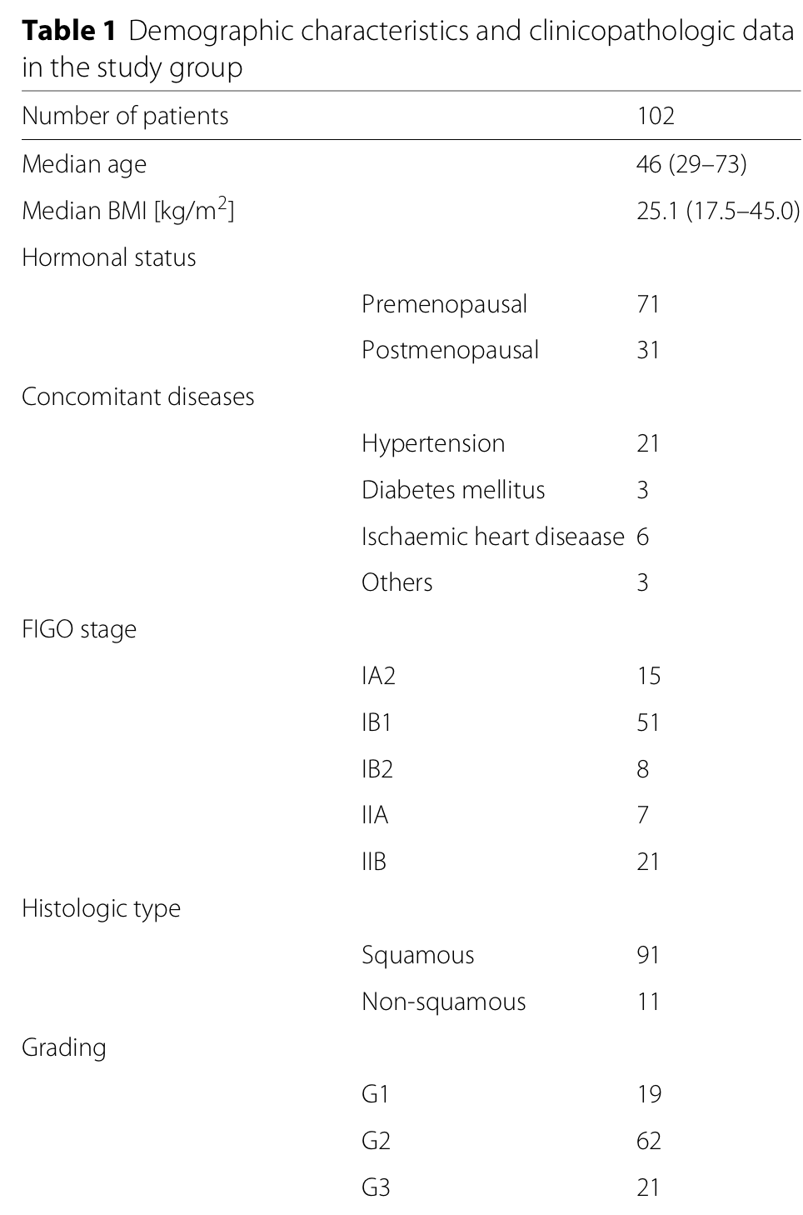
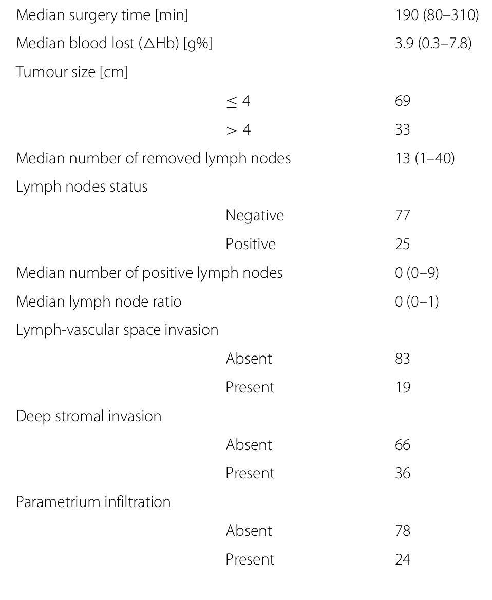
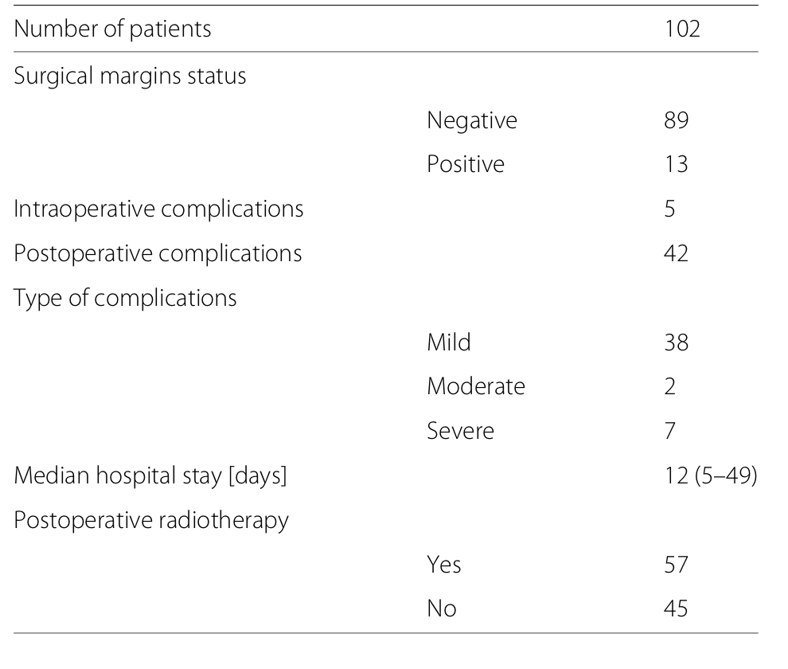

Slide 9
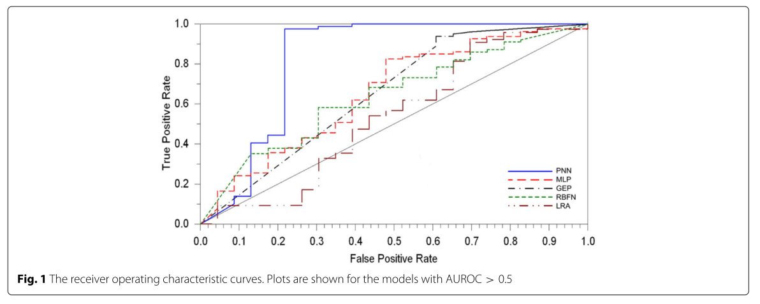
Results
The best results in the prediction of 5–year overall survival in cervical cancer patients treated with radical hysterectomy were obtained by PNN.
This model enabled the prediction of the 5–year overall survival with the highest accuracy (0.892), sensitivity (0.975), and specificity (0.609).
The AUROC for PNN (0.818) also significantly surpassed the values of this parameter for the remaining classifiers (Fig. 1).

Slide 10
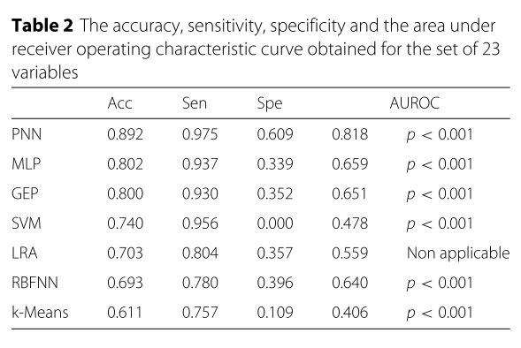
Results
The MLP and GEP also showed high accuracy (0.802 and 0.800, respectively) and sensitivity (≈0.93), but markedly lower specificity.
The averaged accuracy, sensitivity, specificity and AUROC value obtained for all applied computational intelligence methods and linear regression model are presented in Table 2.

Slide 11
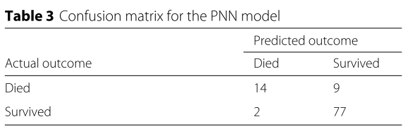
Confusion matrix
As presented in Table 3, of 23 cases of patient death, 9 were incorrectly predicted.
On the other hand, only two cases were misclassified among patients who survived.
PPV = 14/16*100 =87.5%
NPV= 77/86*100 = 89.5%

Slide 12
Discussion
이전의 응용분야, various medical classification tasks
to detect arrhythmia based on digital processing of electrocardiograms
for bleeding detection in wireless capsule endoscopy
for estimating the risk of mortality after cardiac surgery
Our results are comparable to similar reports in which neural networks were applied for outcome prediction of cancer patients.
For example, an artificial neural network was able to predict survival in colorectal cancer patients with an overall accuracy of 90%.
The predictive AUROC of PNN model for 5–year survival in esophageal carcinoma was 0.884.
the ANN model enabled the precise prediction of mortality after primary liver carcinoma with accuracy and AUROC equal to 0.973 and 0.840, respectively.
we used all the listed variables in the simulations.
the accuracy of artificial neural networks could be improved by increasing the number of factors
even non-significant variables must have a non-zero effect on survival.

Slide 13
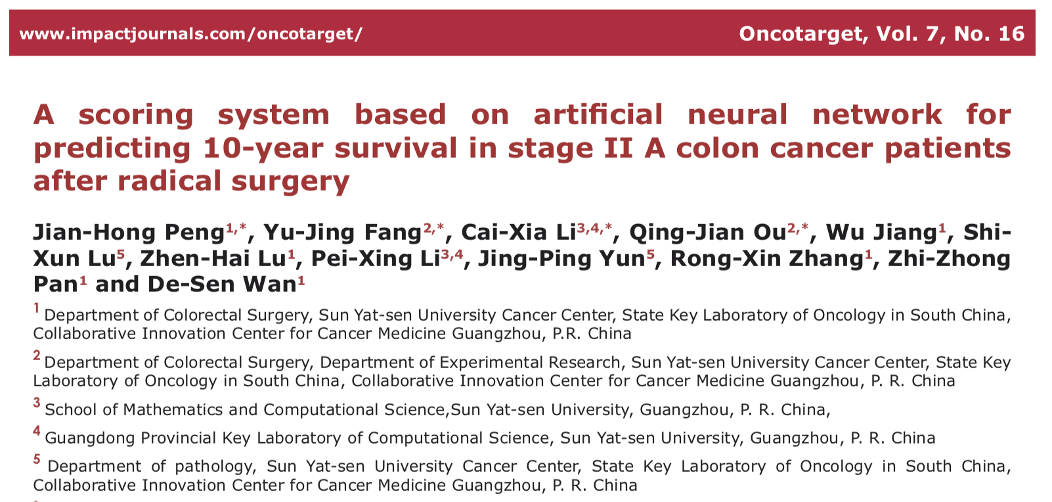
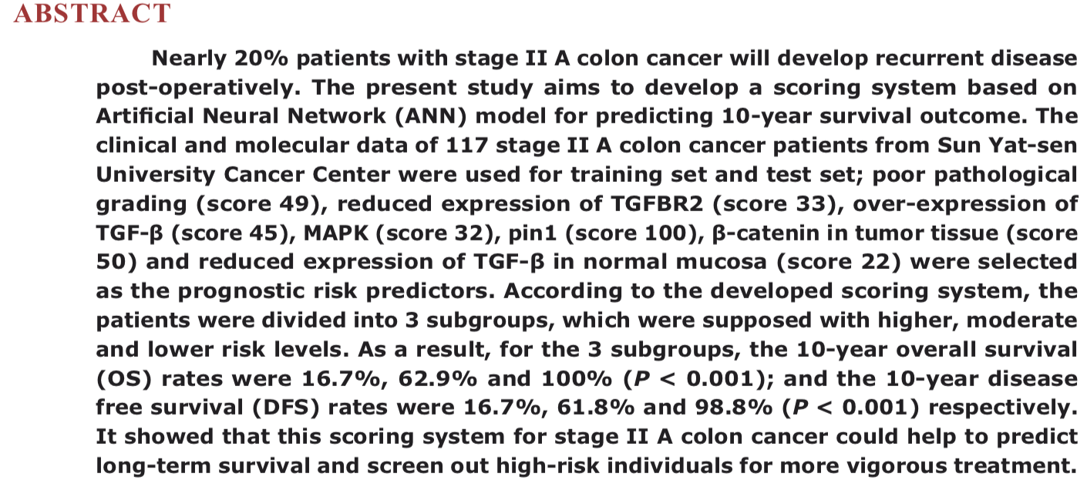

Slide 14
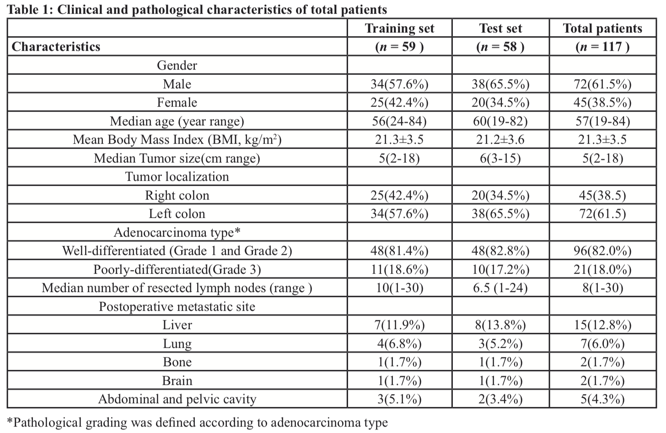
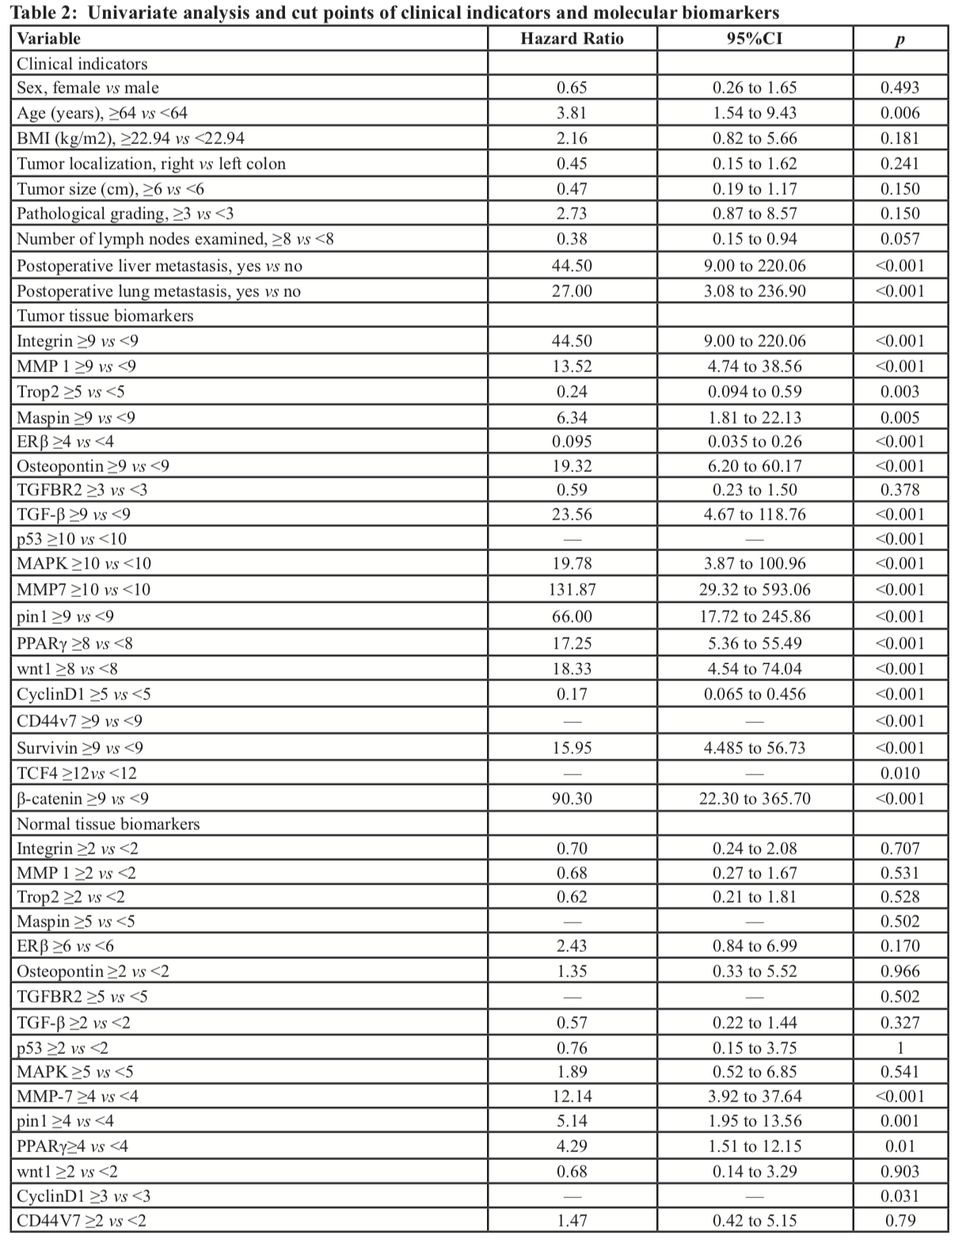
9 clinical features +
19 biomarkers of 117 TMA of stage IIA colon cancer
MLP (multilayer perceptron neutral network)

Slide 15
Statistical analysis
ANN was constructed to predict 10-year survival status using R packages, including “caret” and “nnet” for ANN model selection with recursive backwards feature selection via bootstrap resampling technique, “pROC” for ROC analysis and “rms” for scoring system development.
Basic ANN model of clinical indicators and biomarkers were generated respectively, which was subsequently integrated to establish an ultimate model.
The data of each ANN model was randomly and equally distributed into training set and test set by sample function of R packages.
All ANN models were modeled with training set and evaluated their accuracy with test set.
Scoring system was developed by converting the ultimate ANN model into principal component regression model with predicted values from the ANN model as responses.
The score for each risk factor was assigned according to the regression coefficient.
The total score for each individual was calculated by adding the allocated scores corresponding to a certain 10-year survival probability.
According to the distinguishing survival probability, the patients were divided into distinct risk groups and the difference of 10-year OS and DFS were compared among groups by applying Log-rank test respectively.

Slide 16
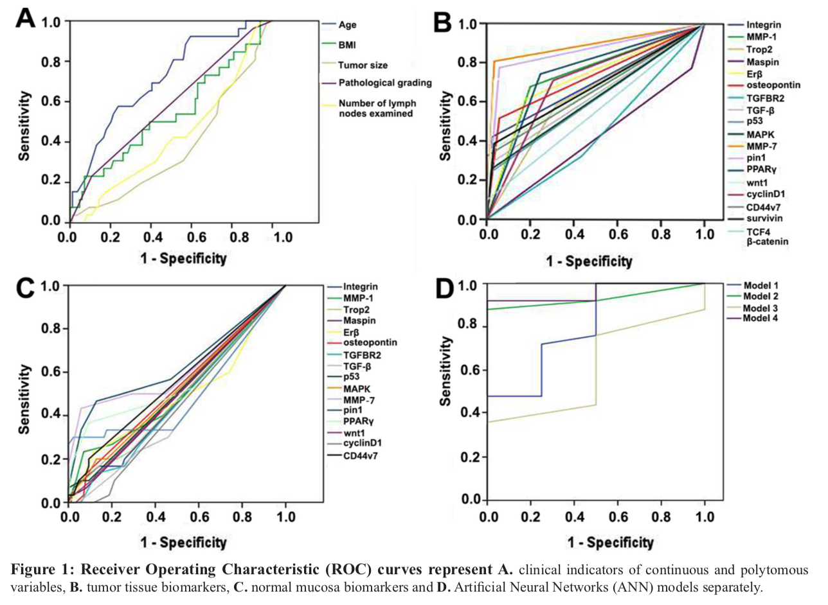
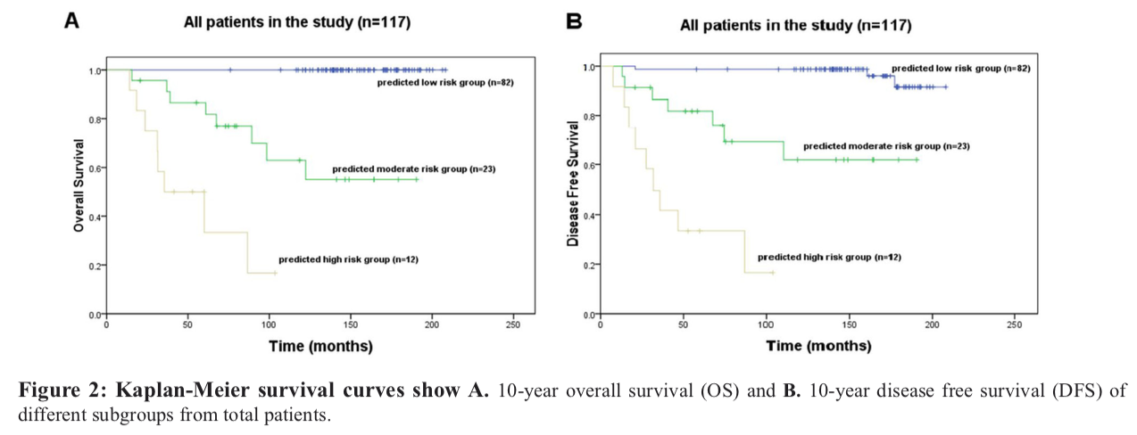
Model 1
Model 2
Model 3
Model 4

Slide 17
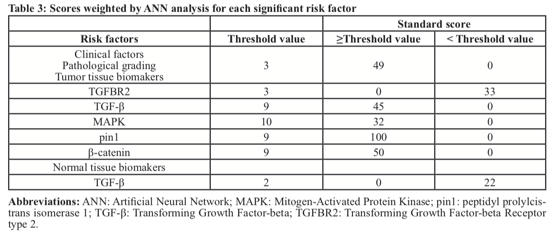
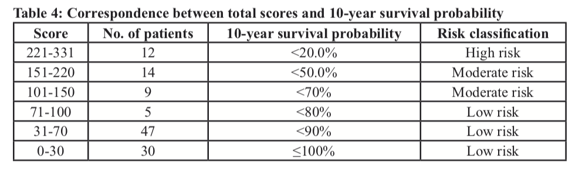
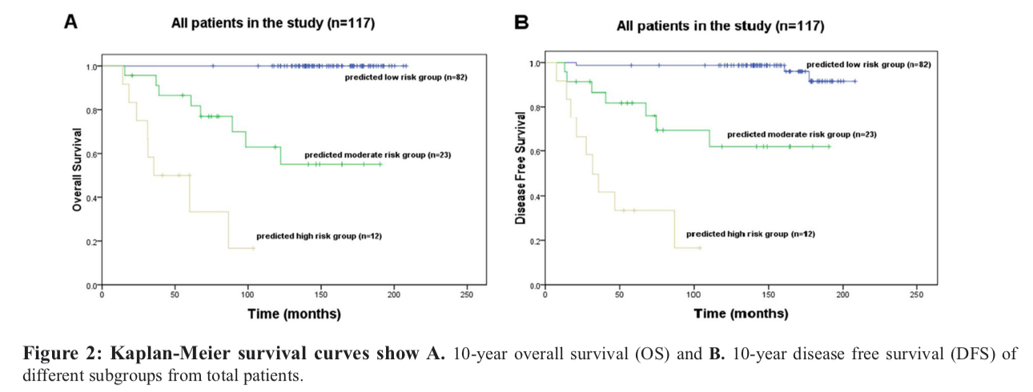
7 significant predictor in Model 4
Scoring system was developed by converting the ultimate ANN model into principal component regression model with predicted values from the ANN model as responses.
The score for each risk factor was assigned according to the regression coefficient.

Slide 18
Comparison of Prognostic prediction between Cox regression model and deep learning model on recurrence of colorectal cancer

Slide 19
Backgrounds
Staging system for cancer are critical to predict the prognosis of patients.
Current staging systems for colon cancer have limitations to predict individualized and precise prediction of patient’s survival after treatment

Slide 20
Objectives
To develop prediction model based on deep learning by estimating the survival probability of patients who underwent curative intent surgery.
To compare the efficacy of prediction of prognosis between machine learning and conventional Cox regression model

Slide 21
Study materials
18 clinicopathologic features
pT stage (1/2/3/4)
pN stage (0/1/2)
TNM stage (2/3)
Number of metastatic lymph node) : continuous variable
Harvested lymph node : continous variable
Preoperative CEA : continuous variable
Adjuvant treatment(Yes/No)
Body mass index : continuous variable
Age : continuous variable
Sex (female/male)
No. of Cormobidity (0/1/over 2)
Circumferential margin involvement (negative/positive)
KRAS mutantation state(Mutant/Wild)
Gross type (fungating, ulcerofungating, ulceroinfiltrative, ulcerative, encircling)
Differentiation (well/moderate/poorly)
Neural invasion(No/Yes)
Vascular invasion(No/Yes)
Lymphatic invasion(No/Yes)
496 patients
324 – colon
188 - rectum
20- cecum
H&E slide
IHC (12) by WX
FN1
SFTPC
EEF1A1
P4HB
DCN
A2M
MGP
GPX3
ACPP
APOE
ACTG1
VIM
Endpoint
Recurrence (Yes/No/NA)
Death (Yes/No)
RFS (duration)
OS (duration)
10yr DFS
5yr DFS
10yr OS
5yr OS
10yr disease free survival rate (%)
5yr disease free survival rate(%)
10yr survival rate (%)
5yr survival rate(%)

Slide 22
Patient Dermographics
Diagnosis | Total | cecum | colon. | rectum. | p
 | (N=532) | (N=20) | (N=324) | (N=188)
Sex |  |  |  |  | 0.024
Male | 312 (58.6%) | 8 (40.0%) | 181 (55.9%) | 123 (65.4%)
Female | 220 (41.4%) | 12 (60.0%) | 143 (44.1%) | 65 (34.6%)
Age | 63.5 ± 12.4 | 60.1 ± 18.0 | 64.2 ± 12.0 | 62.5 ± 12.3 | 0.154
Pre.treatment.CEA | 12.6 ± 88.2 | 8.3 ± 14.5 | 15.6 ± 109.7 | 7.7 ± 34.3 | 0.607
BMI | 23.9 ± 3.7 | 24.2 ± 3.8 | 23.9 ± 3.9 | 23.8 ± 3.3 | 0.898
No. of comorbidity |  |  |  |  | 0.085
0 | 211(39.7%) | 11 (55.0%) | 119 (36.7%) | 81 (43.1%)
1 | 208 (39.1%) | 5 (25.0%) | 131 (40.4%) | 72 (42.0%)
Over 2 | 113 (21.2%) | 4 (20.0%) | 74 (22.9%) | 35(14.9%)
pT stage |  |  |  |  | 0.409
1 | 8 ( 1.5%) | 0 ( 0.0%) | 3 ( 0.9%) | 5 ( 2.7%)
2 | 25 ( 4.7%) | 1 ( 5.0%) | 13 ( 4.0%) | 11 ( 5.9%)
3 | 429 (80.6%) | 15 (75.0%) | 261 (80.6%) | 153 (81.4%)
4 | 70 (13.2%) | 4 (20.0%) | 47 (14.5%) | 19 (10.1%)
pN stage |  |  |  |  | 0.667
0 | 262 (49.2%) | 12 (60.0%) | 152 (46.9%) | 98 (52.1%)
1 | 159 (29.9%) | 5 (25.0%) | 100 (30.9%) | 54 (28.7%)
2 | 111 (20.9%) | 3 (15.0%) | 72 (22.2%) | 36 (19.1%)
TNM stage |  |  |  |  | 0.258
II | 262 (49.2%) | 12 (60.0%) | 151 (46.6%) | 99 (52.7%)
III | 270 (50.8%) | 8 (40.0%) | 173 (53.4%) | 89 (47.3%)
CRM positivity |  |  |  |  | 0
0 | 192 (36.1%) | 12 (60.0%) | 156 (48.1%) | 24 (12.8%)
0 | 67 (12.6%) | 0 ( 0.0%) | 67 (20.7%) | 0 ( 0.0%)
0 | 110 (20.7%) | 8 (40.0%) | 101 (31.2%) | 1 ( 0.5%)
0 | 135 (25.4%) | 0 ( 0.0%) | 0 ( 0.0%) | 135 (71.8%)
Positive | 28 ( 5.3%) | 0 ( 0.0%) | 0 ( 0.0%) | 28 (14.9%)
Harvested.LNs | 22.4 ± 13.2 | 25.0 ± 9.8 | 25.1 ± 13.8 | 17.3 ± 10.9 | 0
No.of.LN.meta | 2.2 ± 3.9 | 1.2 ± 1.8 | 2.3 ± 4.1 | 2.1 ± 3.7 | 0.41

Slide 23
Patient Dermographics
Diagnosis | Total | cecum | colon. | rectum. | p
Differentiation |  |  |  |  | 0.149
Well | 20 ( 3.8%) | 0 ( 0.0%) | 13 ( 4.0%) | 7 ( 3.7%)
Moderate | 488 (91.9%) | 17 (85.0%) | 296 (91.6%) | 175 (93.1%)
Poorly | 23 ( 4.3%) | 3 (15.0%) | 14 ( 4.3%) | 6 ( 3.2%)
Neural.Invasion |  |  |  |  | 0.292
Absent | 346 (65.2%) | 9 (45.0%) | 209 (64.7%) | 128 (68.1%)
Present | 184 (34.7%) | 11 (55.0%) | 113 (35.0%) | 60 (31.9%)
Unknown | 1 ( 0.2%) | 0 ( 0.0%) | 1 ( 0.3%) | 0 ( 0.0%)
Vascular.Invasion |  |  |  |  | 0.389
Absent | 448 (84.4%) | 17 (85.0%) | 267 (82.7%) | 164 (87.2%)
Present | 83 (15.6%) | 3 (15.0%) | 56 (17.3%) | 24 (12.8%)
Lymphatic.Invasion |  |  |  |  | 0.783
Absent | 334 (62.9%) | 12 (60.0%) | 198 (61.3%) | 124 (66.0%)
Present | 196 (36.9%) | 8 (40.0%) | 124 (38.4%) | 64 (34.0%)
Unknown | 1 ( 0.2%) | 0 ( 0.0%) | 1 ( 0.3%) | 0 ( 0.0%)
K.ras |  |  |  |  | 0
Wild | 168 (31.7%) | 10 (50.0%) | 107 (33.0%) | 51 (27.1%)
Mutant | 100 (18.8%) | 2 (10.0%) | 63 (19.5%) | 35 (18.6%)
Unknown | 264 (49.6%) | 8 (40.0%) | 154 (47.5%) | 102 (54.3%)

Slide 24
Univariate Cox regression
 | Characteristics | Odds ratio (95% CI) | Crude P-value
1 | pT stage (1/2/3/4) | 1.651 (1.143 - 2.384) | 0.0075*
2 | pN stage (0/1/2) | 1.381 (1.124 - 1.697) | 0.0021*
3 | TNM stage (2/3) | 1.693 (1.194 - 2.401) | 0.0031*
4 | Number of metastatic lymph node (pathologic proven) | 1.067 (1.032 - 1.103) | 0.0001*
5 | Harvested lymph node during surgery | 0.985 (0.9700 - 1.000) | 0.0499 *
6 | Pre-treatment serum CEA | 1.002 (1.001 - 1.003) | 0.0004*
7 | Adjuvant treatment Yes vs No | 0.897 (0.598 - 1.346) | 0.599
8 | Body mass index | 0.947 (0.903 - 0.994) | 0.0264*
9 | Age | 1.006 (0.992 - 1.021) | 0.379
10 | Sex Male vs Female | 0.660 (0.461 - 0.9470) | 0.0238 *
11 | Cormobidity None vs. 1 vs over 2 | 1.531 (1.0427 – 2.247) 1.231 (0.7677 – 1.973) | 0.0298* 0.3886
12 | Resection margin R0 vs R1 | 2.313 (1.306 – 4.098) | 0.0041*

Slide 25
13 | Diagnosis Colon vs Rectum vs Cecum | 0.6071 (0.2638 – 1.397) 0.8994 (0.3880 – 2.085) | 0.241 0.805
14 | KRAS mutantation state Mutant vs Wild | 1.4543 (0.8899 – 2.377) | 0.135
15 | Gross type Fungating vs ulcerofungating vs ulceroinfiltrative,vs ulcerative vs encircling vs etc | 1.059e+00 (0.5240-2.142) 1.277e+00 (0.6333-2.576) 3.478e-07 (0.0000-inf) 3.474e-07 (0.0000-inf) 1.687e+00 (0.6002-4.740) | 0.872 0.494 0.995 0.995 0.321
16 | Differentiation (Poor/Mod vs Well) | 1.0169 (0.5506 – 1.8789) | 0.957
17 | Neural invasion (Presence vs Absence) | 1.1447 (0.8177 – 1.602) | 0.431
18 | Vascular invasion (Presence vs Absence) | 1.5636 (1.031 – 2.372) | 0.0355*
19 | Lymphatic invasion (Presence vs Absence) | 1..1656 (0.8313 – 1.64) | 0.371
** 11 effective features on recurrence in univariate Cox regression model :
pT, pN, Stage, No. of metastatic LNs, Harvested LNs, CEA, BMI, Sex, No. of comorbidity, Resection margin, Vascular invasion

Slide 26
Multivatiate Cox regression
 | Characteristics | Odds ratio (95% CI) | Adjusted P-value
1 | pT stage (1/2/3/4) | 1.516 (1.056 – 2.175) | 0.024*
2 | pN stage (0/1/2) | 1.350 (1.086 – 1.680)) | 0.007*
5 | Harvested lymph node during surgery | 0.980 (0.964 – 0.996) | 0.015*
6 | Pre-treatment serum CEA | 1.002 (1.001 – 1.003) | 0.0004*
8 | Body mass index | 0.930 (0.884 – 0.978) | 0.005*
10 | Sex Male vs Female | 0.617 (0.428 – 0.886) | 0.009*
11 | Cormobidity None vs. 1 vs over 2 | 1.663 (1.123 – 2.461) | 0.011*
18 | Vascular invasion Present vs Absent | 1.113 (0.710 – 1.744) | 0.640
** 7 effective features on recurrence in multivariate Cox regression model :
pT, pN, No. of Harvested LNs, CEA, BMI, Sex, No. of comorbidity

Slide 27
Study Design
496 Curatively resected (Stage II-III)
Between April 2006 and February 2015
Incheon St. Mary’s Hospital (validation set)
+
19 clinico-pathologic features
+
H&E picture
+
IHC (12) by WX
FN1
SFTPC
EEF1A1
P4HB
DCN
A2M
MGP
GPX3
ACPP
APOE
ACTG1
VIM
Deep learning architecture
Using clinical, image (H&E), molecular features(IHC)
Secondary
endpoint
Weighted
Scoring system
Prediction of prognosis
Primary endpoint
The comparison between machine learning and Cox regression model on risk prediction of recurrence of CRC
Conventional Cox regression model
sensitivity
specificity
accuracy
AUROC
AUROC를 Paired t-test 로 비교

